Slide 1
Part 1: overview
Principal Component Analysis (PCA)
Maximal variance principle
Single dataset
Partial Least Squares (PLS)
Two-way Orthogonal PLS (O2PLS)
Group sparse O2PLS
Post-hoc analyses using external databases
Notes:
Theory 5 – 10 min
Data

Slide 2
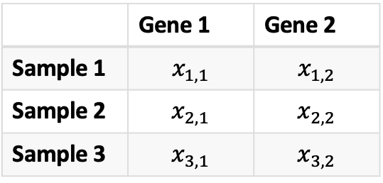
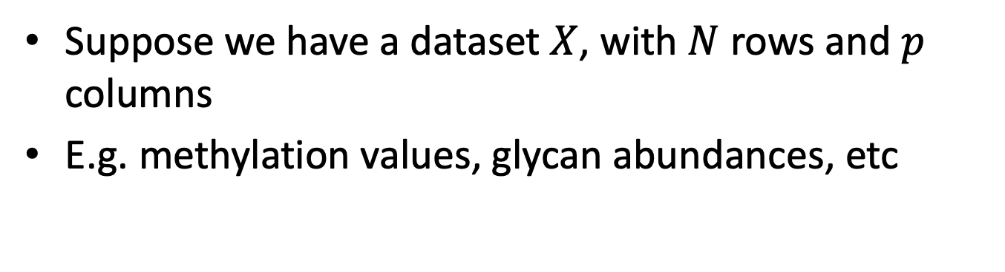
Introduction
Suppose we have a dataset $X$, with $N$ rows and $p$ columns
E.g. methylation values, glycan abundances, etc
How to inspect these variables and their correlations?
 | Gene 1 | Gene 2
Sample 1 | $$x_{1,1}$$ | $$x_{1,2}$$
Sample 2 | $$x_{2,1}$$ | $$x_{2,2}$$
Sample 3 | $$x_{3,1}$$ | $$x_{3,2}$$

Slide 3
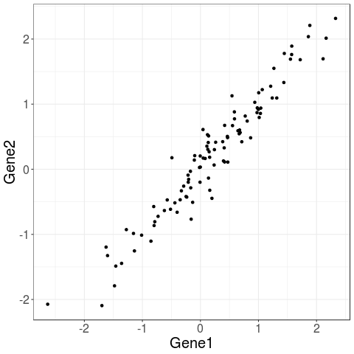
Example: bivariate data
Suppose we have two genes
They are highly correlated
How would you represent these data? Do you need both dimensions?
In general, aggregate data across direction of maximal variance

Slide 4
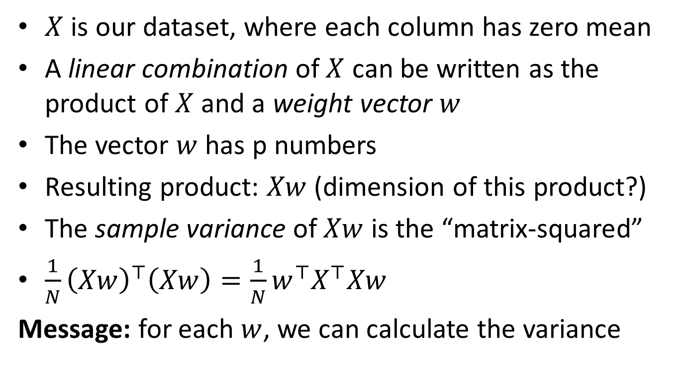
PCA principle: maximal variance
$X$ is our dataset, where each column has zero mean
A linear combination of $X$ can be written as the product of $X$ and a weight vector $w$
The vector $w$ has p numbers
Resulting product: $Xw$ (dimension of this product?)
The sample variance of $Xw$ is the “matrix-squared”
$\frac{1}{N}{\left(Xw\right)}^{⊤}\left(Xw\right)=\frac{1}{N}w^{⊤}X^{⊤}Xw$
Message: for each $w$, we can calculate the variance
Notes:
Interpretation what we are doing, loadings, scores

Slide 5
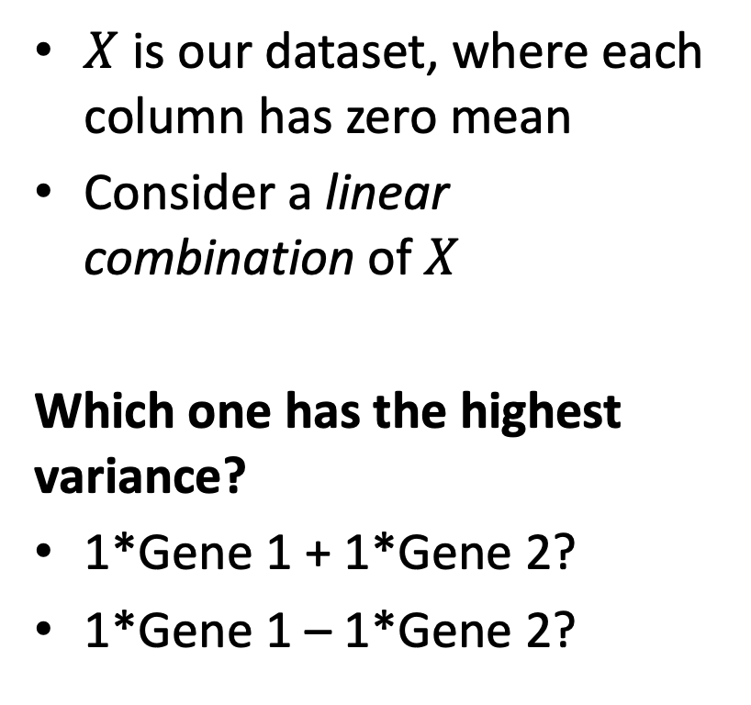
PCA principle: maximal variance
$X$ is our dataset, where each column has zero mean
Consider a linear combination of $X$
Which one has the highest variance?
1*Gene 1 + 1*Gene 2?
1*Gene 1 – 1*Gene 2?
Notes:
Interpretation what we are doing, loadings, scores

Slide 6
PCA algorithm: estimation
Objective: maximize variance of linear combination
The combination is relative
Multiply numbers by 0.1, or 1, or 100 times is equivalent
Can be calculated using
A singular value decomposition (svd in R)
Message: first principal component is first (right) singular vector
Notes:
rm

Slide 7
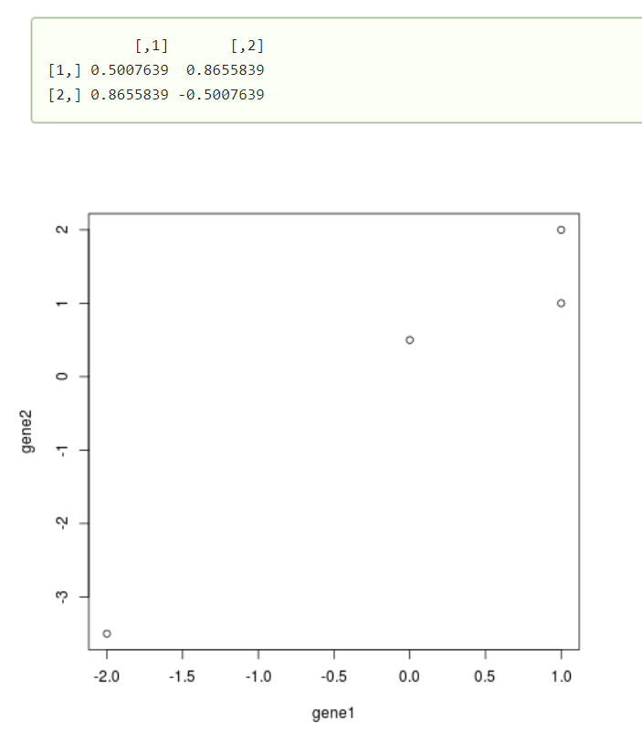
An example in R
gene1 <- c(-2, 0, 1, 1)
gene2 <- c(-3.5, 0.5, 2, 1)
plot(gene1, gene2)
svd(cbind(gene1, gene2))$v
The best weight is (0.5,0.87)
So: 0.5 times gene 1 and 0.87 times gene 2 gives the highest variance
Notes:
Practice with dataset, html

Slide 8
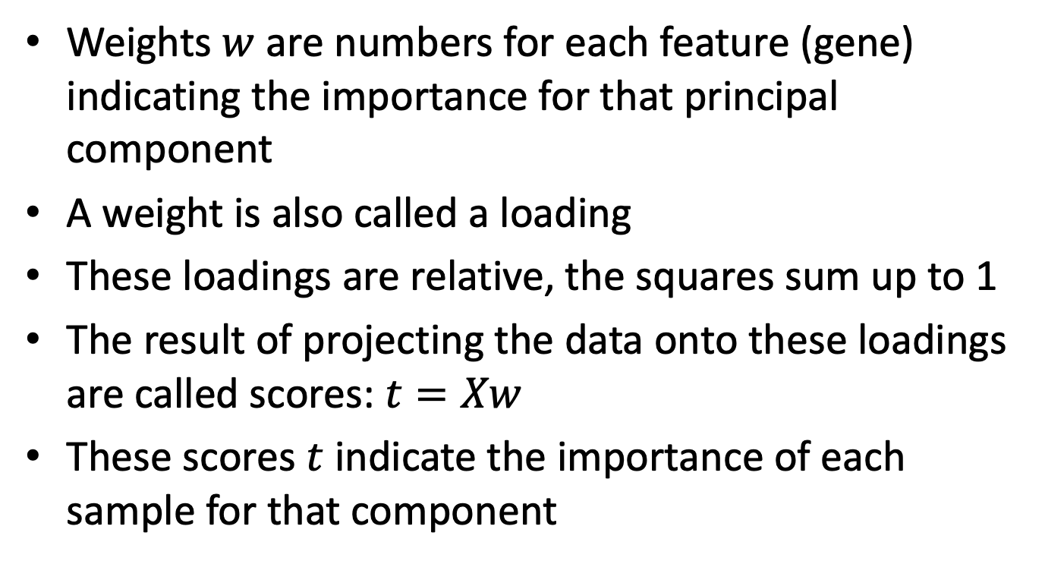
PCA: interpretation of the results
Weights $w$ are numbers for each feature (gene) indicating the importance for that principal component
A weight is also called a loading
These loadings are relative, the squares sum up to 1
The result of projecting the data onto these loadings are called scores: $t=Xw$
These scores $t$ indicate the importance of each sample for that component

Slide 9
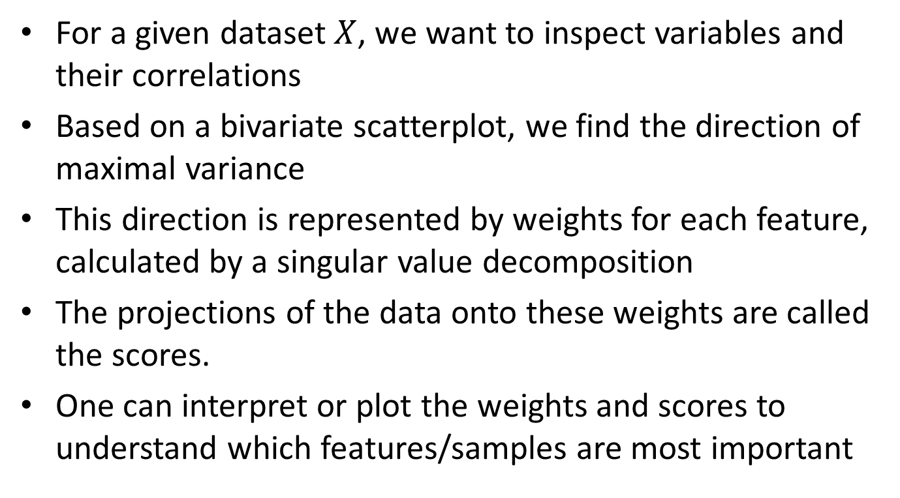
Principal component analysis: summary
For a given dataset $X$, we want to inspect variables and their correlations
Based on a bivariate scatterplot, we find the direction of maximal variance
This direction is represented by weights for each feature, calculated by a singular value decomposition
The projections of the data onto these weights are called the scores.
One can interpret or plot the weights and scores to understand which features/samples are most important

Slide 10
Down syndrome data
Methylation and glycomics data on Down syndrome patients and controls
29 trios: a DS patient and its sibling and mother
A subset of 450k methylation intensity values
We only consider chromosome 21 and targeting a gene
Yields 3322 CpG sites
Ten (plasma N-)glycan peaks
Divide by the total abundance, apply log

Slide 11
Exercises
Load the Down Syndrome data and describe the datasets.
Use boxplots, histograms and frequency tables
Perform PCA on glycomics, using svd, and inspect the loadings of the first component
Calculate and plot the scores of the first component

Slide 12
Exercises
Load the Down Syndrome data and describe the datasets.
Use boxplots, histograms and frequency tables
Perform PCA on glycomics, using svd, and inspect the loadings of the first component
Calculate and plot the scores of the first component

Slide 13
Part 1: overview
Principal Component Analysis (PCA)
Maximal variance principle
Single dataset
Partial Least Squares (PLS)
Two-way Orthogonal PLS (O2PLS)
Group sparse O2PLS
Post-hoc analyses using external databases
Notes:
Theory 5 – 10 min
Data

